Slide 1
Machine Learning
Introduction

Slide 2
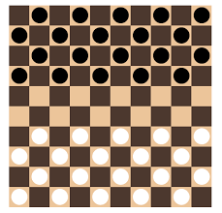
Human Learning vs. Machine Learning
Learning is the ability to improve one’s behavior with experience.
Experiencing a class of problems and their solutions to ….find new solutions, possibly better ones, given a similar problem in future.
Checkerboard game
Play better with experience

Slide 3
Human Learning vs. Machine Learning
Can machine learn the way human learns?
Can machine play a checkerboard game?
The first ML System was developed by Arthur Samuel in 1952 for playing checkerboard.
Sumuel’s Definition of ML: The field of study that gives computers the ability without being explicitly programmed.

Slide 4
Learning from data instances
Learn the instances to find a model that predicts future
Inputs |  | Output
X1 | X2 | y
1 | 5 | 12
2 | 4 | 16
3 | 8 | 25
5 | 3 | 30
8 | 6 | 48
4 | 7 | ??
Linear Model: y = 2 + 5 X₁ + X₂
y = θ₀ + θ₁ X₁ + θ₂ X₂ where θ₀=2, θ₁=5, θ₂=1
θ₀, θ₁, θ₂ are the model paramers

Slide 5
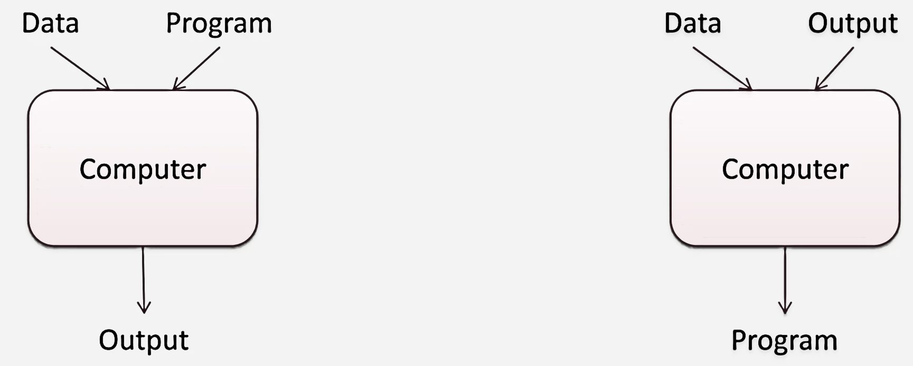
Programs vs. learning algorithms
Programatic Solution Machine Learning Solution

Slide 6
Machine Learning
Machine Learning explores algorithms that
learn or build models from data
Models to be used for tasks like prediction, decision making or solving similar tasks

Slide 7
Formal definition of ML
A computer program is said to learn from experience E with respect to some class of tasks T and performance measure P, if its performance at tasks in T, as measured by P, improves with experience E. - Tom Mitchell
For checkerboard game:
E: different board positions and next move
T: Sequence of moves leading to win
P: Percentage of win

Slide 8
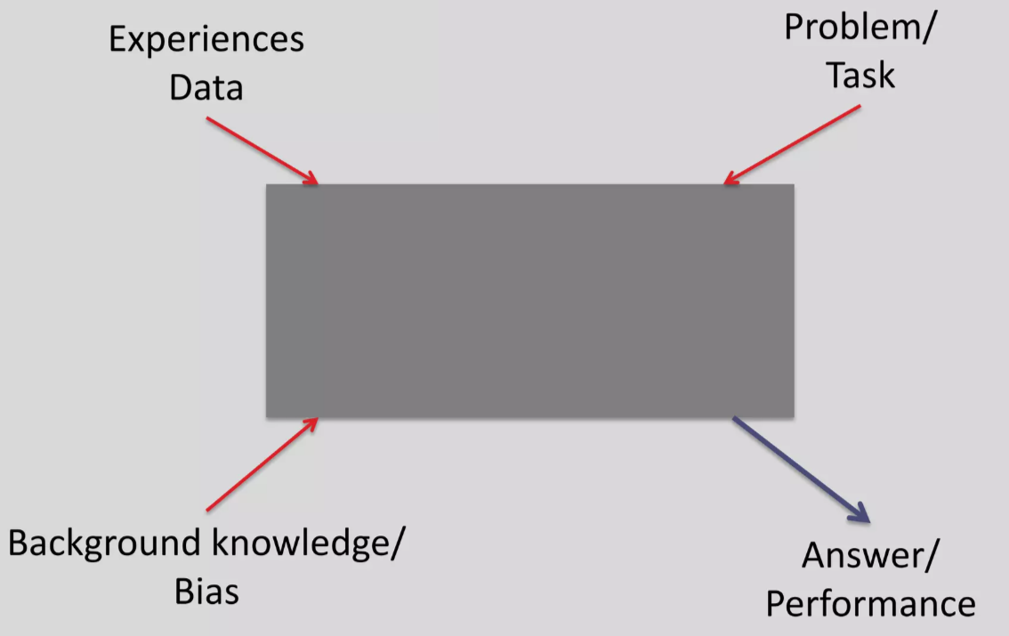
Black-box leaner
Learning System

Slide 9
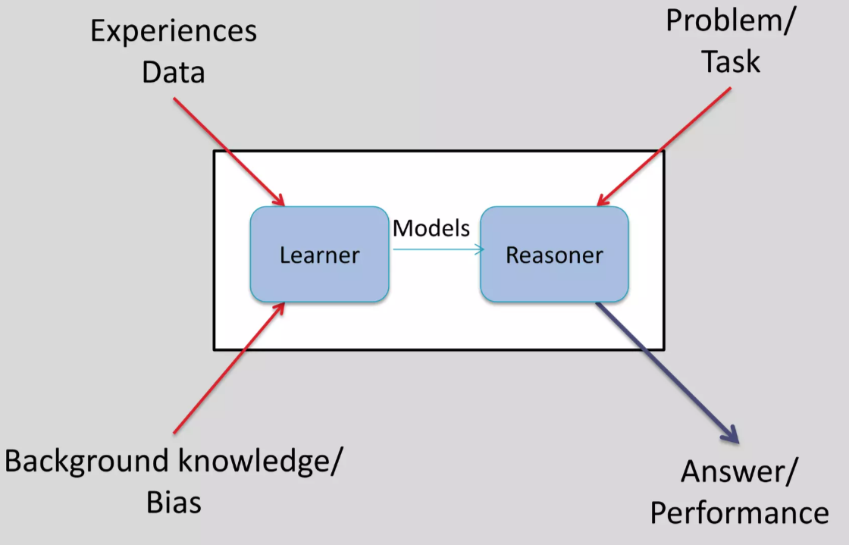
Black-box leaner
Learner
Reasoner

Slide 10

Applications
email spam tagging:
T: Classifying emails as spam or not spam
E: Program watching you label emails as spam or not spam
P: The number/fraction of emails classified correctly as spam or not spam

Slide 11
Many domains and applications
Medicine domain:
Diagnose a disease
Input: symptoms, lab measurements, test results, DNA tests,
Output: one of set of possible diseases, or "none of the above“
Data: historical medical records
Learn: which future patients will respond best to which treatments

Slide 12
Many domains and applications
Computer Vision:
say what objects appear in an image
detect where objects appear in an image
convert hand-written digits to characters 0..9

Slide 13
Many domains and applications
Robot Control:
Design autonomous mobile robots that learn from experience to navigate from their own experience

Slide 14
Many domains and applications
NLP:
detect where entities are mentioned in NL
detect what facts are expressed in NL
detect if a product/movie review is positive, negative, or neutral
Speech recognition
Machine translation

Slide 15
Many domains and applications
Financial:
predict if a stock will rise or fall
predict if a user will click on an ad or not

Slide 16
Many domains and applications
Financial:
predict if a stock will rise or fall
predict if a user will click on an ad or not
Predict product sales quantities taking seasonality and trend into account

Slide 17
Many domains and applications
Security:
Credit card fraud detection

